Slide 1
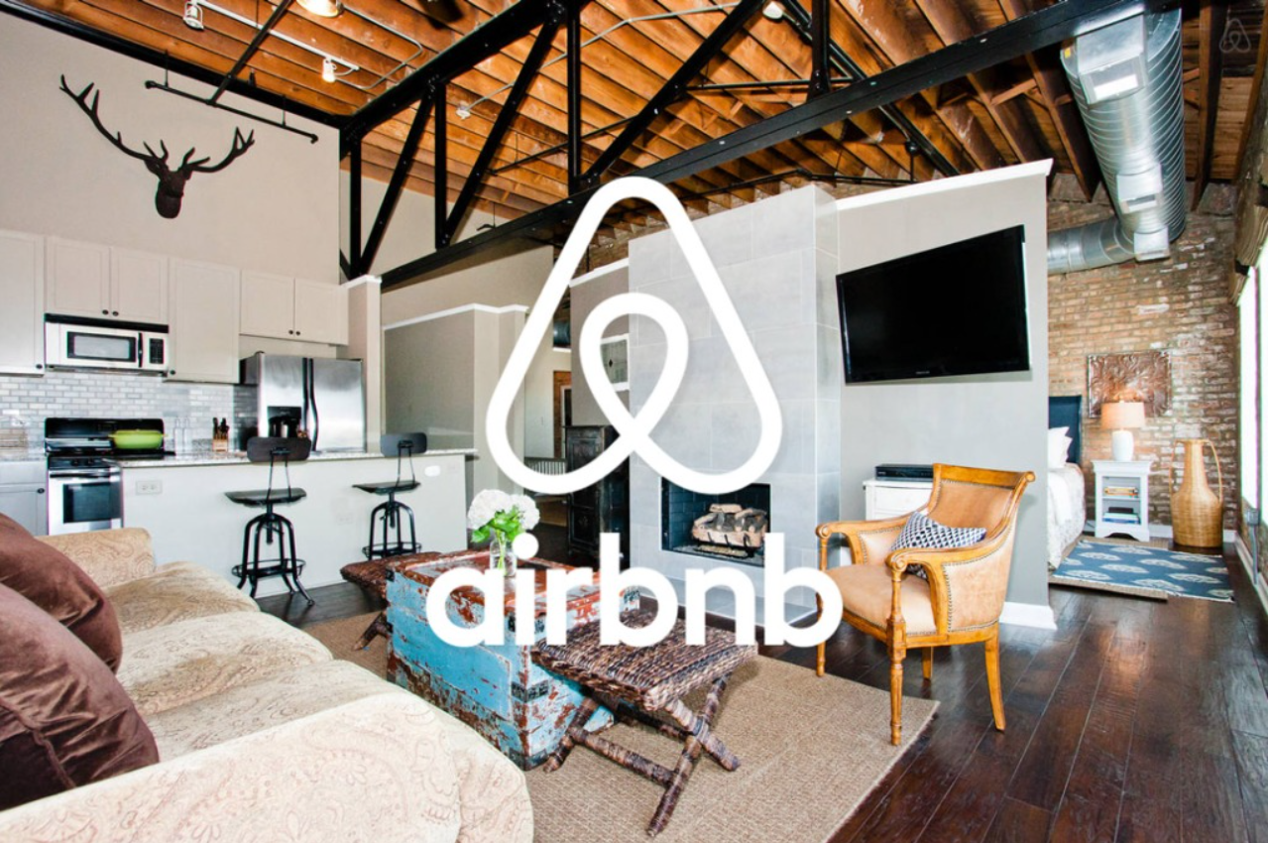
Airbnb Data Analysis
-Darshan
-Ritesh

Slide 2
Objective:
To get the insights of top hosts, revenue, reviews and overall satisfaction rate of the bookings in the various neighborhoods in the Amsterdam. Insights includes average ratings by room types , average price by room type, average price in each neighborhood , etc.
Benefits:
We will be able to get the insights about top hosts, neighborhoods, their reviews, overall satisfaction rate and average price for each room type.
Helps Stakeholders in expanding their network, improve their services, resulting in more bookings and revenue, etc.

Slide 3
Data Sharing Agreement :
file name (Airbnb_prices.csv )
Length of Date stamp( 8 Digits )
Length of Time stamp ( 6 Digits )
Number of Columns
Column Name
Column Data type

Slide 4
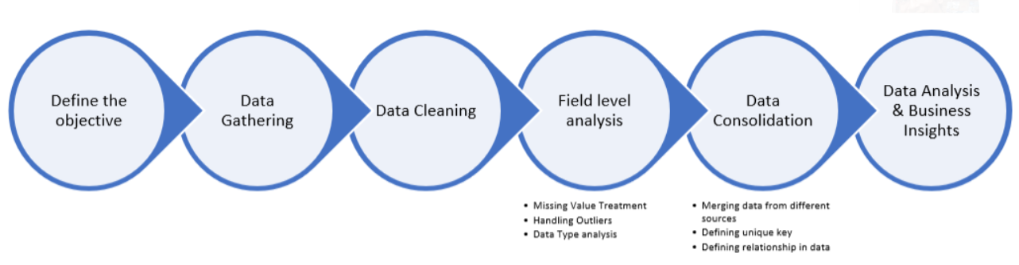
Architecture

Slide 5
Data Overview:
Data has a total count of 18724, in a single csv file.
It includes data from 22 July 2017 to 23 July 2017.
KPIs (Key Performance Indicators)
Key indicators displaying a summary of the Airbnb Data and its relationship with different metrics.
(Room_ID,Host_ID, Room type, Neighborhood, Overall_satsfaction, city, Reviews, Accommodate, Bedrooms, Price, Name, Last modified, Latitude, Longitude, Location).

Slide 6
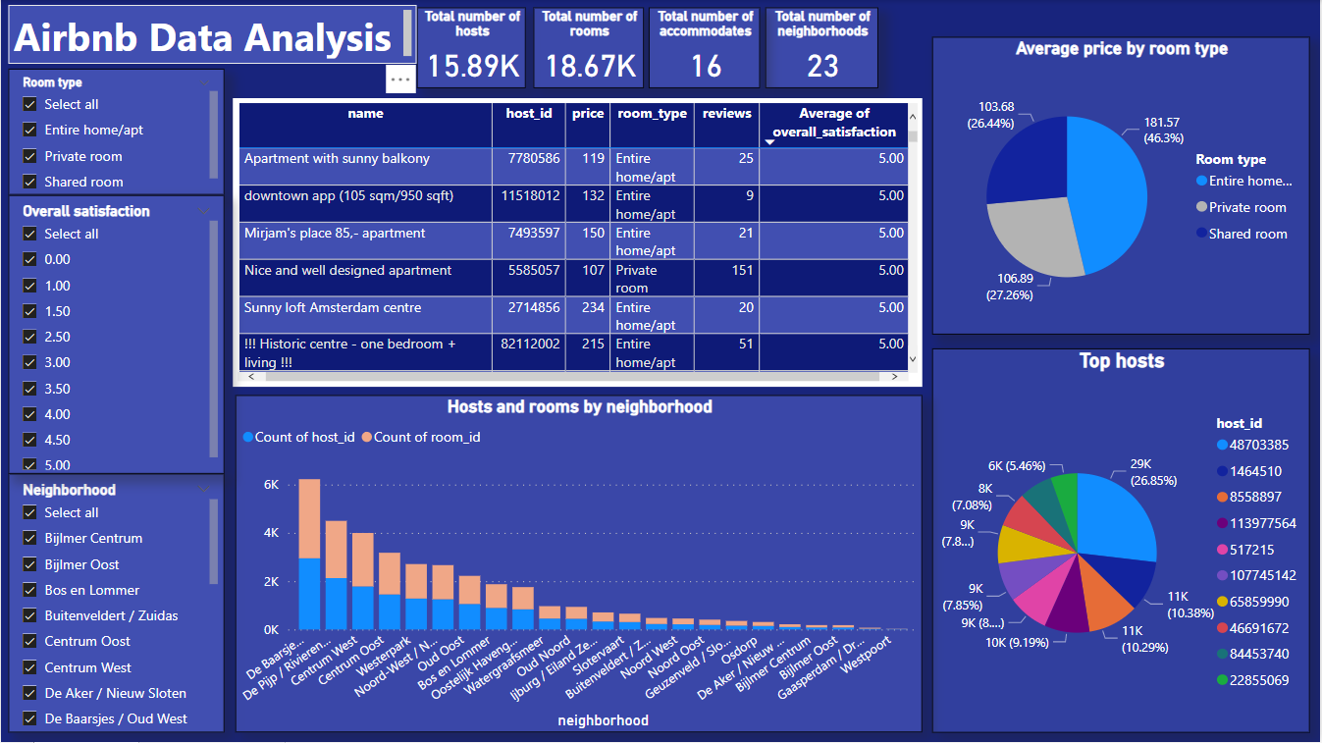
Dashboard:

Slide 7
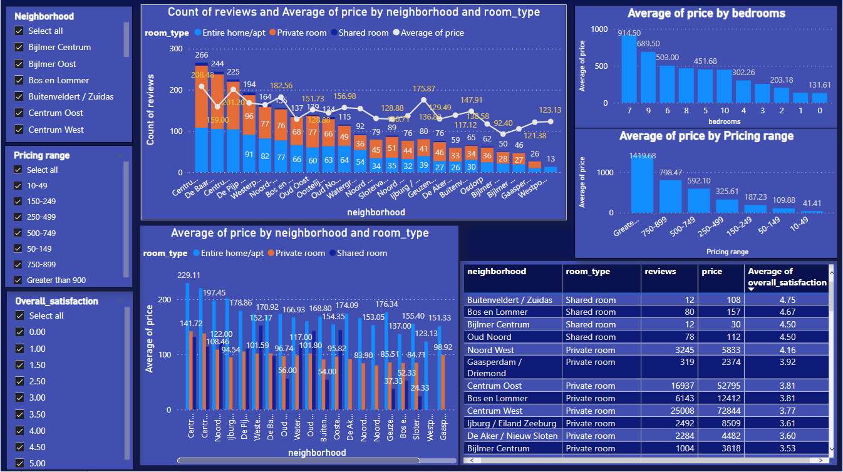

Slide 8
Summary:
1.There are Total 15.89K hosts providing the services.
2.There are Total 18.67K rooms available.
3.Total of 23 neighborhoods have Airbnb services.
4.Total number of accommodates are 16
4.De Baarsjes / Oud West has highest number of hosts and rooms available in service.
5.Whereas De Pijp / Rivierenbuurt has the second highest number hosts and rooms available in service.
The average price for different types of rooms are:
>Private Room – $ 106.89
>Shared Room - $ 103.68
>Entire Home / Appt - $ 181.57

Slide 9
7.There are 46.3% rooms are in the category of Entire Home / Appt which is almost close to half of the rooms.
8.Private rooms are 27.26% and Shared rooms are 26.44% of the total rooms.
9.De Baarsjes / Oud West, Centrum Oost and De Pijp / Rivierenbuurt are the top three neighborhoods which have received the maximum number of reviews.
10.The Top 3 Expensive Neighborhoods by average prices are –
- Centrum West :- $ 229.11
- Centrum Oost :- $ 219.73
- Ijburg/Eiland Zeeburg :- $ 201.37

Slide 10
11.Top 3 cheapest Neighborhoods by average price are –
- Slotervaart - $ 24.33
- Bijlmer Centrum - $ 30
- Geuzenveld/ Slotermeer - $ 37.33
12.The prices of rooms vary with the bedrooms. The rooms with 7 bedrooms have highest average price of $914.50.
13. The average room prices of each price brackets are:
> $10 to $49 - Entire home / Apt – $39.25
Private Room – $42.17
Shared Room - $ 36.64

Slide 11
> $50 to $149 – Entire home / Apt – $116.93
Private Room – $94.3
Shared Room - $87.55
>$150 to $249 - Entire home / Apt – $187.7
Private Room – $181.14
Shared Room - $189.38
>$250 to $499 – Entire home / Apt – $325.8
Private Room – $316.11
Shared Room - $392.33
>$500 to $749 - Entire home / Apt – $592.10
>$750 to $899 – Entire home / Apt – $798.47
>Greater Than 900 – Entire home / Apt – $1419.68

Slide 12
Q & A
1) What’s the source of the dataset ?
ANS – The dataset is provide by the client.
2) What was the type of Data ?
ANS – The data was the combination of numerical and Categorical values available in csv format.
3) What’s the complete flow you followed in this project ?
ANS – Kindly refer to the 4th slide for better understanding.
4) What steps I should follow to get insights from the data?
ANS – Step.1 Download the data and store it in a location in your pc.
Step.2 . Open Airbnb_Analysis_Report.pbix in your pc and then you can see all the insights.

